Slide 1

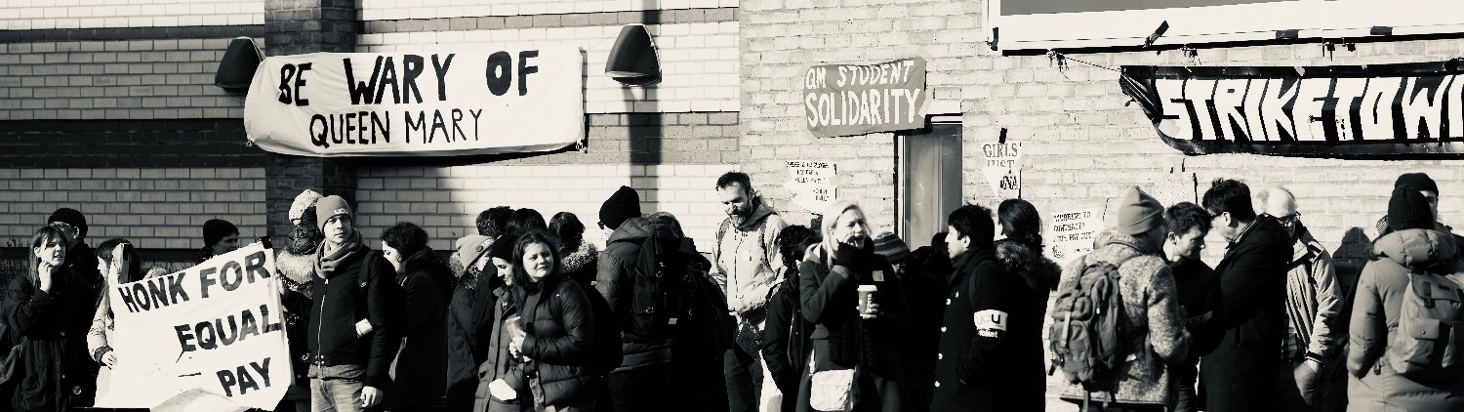
Absolutely
MABulous
A national Marking & Assessment Boycott is the most powerful tool UCU has had to change the direction and priorities of Higher Education. There is a lot of collective knowledge in the union using MABs effectively.
Experiences and Reflections from QMUCU

Slide 2


01.
BACKGROUND
What happened at QMUL in 2022
02.
EARLY PREPARATION
What to do now
03.
DURING THE BOYCOTT
With branch, management, student, externals
04.
AFTER
How to end? How to follow up?

Slide 3
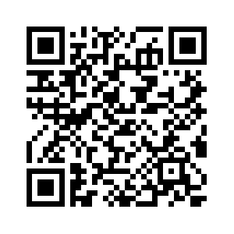
BRIEF BACKGROUND
WE KNOW WHAT WE DID LAST SUMMER
Local action in response to ASOS deductions
Pre-MAB
May-August
July Deductions
Aftermath
10 days of local strike action
Four months withholding marks and putting management in a corner
Local settlement (£700 increase to London Weighting for all staff; Joint work agreements on 4F; no August deductions)
Grievances & Legal action
Just over 100 members deducted 100% pay on ASOS policy in July

Slide 4



EARLY PREPARATION
Mapping
Network building
Templates
  Identify crunch points (marking deadlines; exam boards; graduation deadlines; resit deadlines)
  Identify impactful modules
  Spreadsheet of number of scripts per department
  Regular meetings with reps
  Build links with PS staff to understand procedure
  Reach out to non-union members and those without marking to avoid them breaking the boycott & suggest wage share
  For student communication
  To respond to demands of mark submission
  To reach out to external examiners
  To encourage non-markers not to break the boycott
2022
Company

Slide 5
Robust and stable communication infrastructure to absorb uncertainties, deal with urgencies, keep the branch committee informed.
Use the MAB: create a Black Box of information to trip up management.
INTERNAL
MG
MT
Use the uncertainty
Build a buffer
Make the reputational damage and the destruction of Quality Assurances the problem of the Governing Body.
Student-facing branch-level information to protect members and give students the tools to use the MAB.
STUDENTS
EXTERNAL
UNCERTAINTY AS A TOOL

Slide 6
INTERNAL
Daily Solidaritea
Daily open zoom for general check-in for updates, for people to vent, themed sessions (i.e. TA/TFs, migrant members).
Robust and stable communication infrastructure to absorb uncertainties, deal with urgencies, keep the branch committee informed
Responsiveness through meetings
Meetings reveal members' exposure; boycott breaking; outsourcing; poor feedback; ebb & flow of PS staff’s role
Regular departmental meetings
Local meetings encourage cohesion, discourage scabs, and feed local concerns to the branch-level.
Preparing for timeline of pressure
MAB changes over time. Prepare to deal with and use the extra pressure of crunch points when management has deadlines: Summer Exam Board deadline, graduation, resit deadline, Resit Exam board deadline

Slide 7
MANAGEMENT
No need to answer individual demands
Members are under no specific legal obligation to respond, but if they respond they have to do so truthfully. Daily meetings are a place to check in about particular emails or line manager requests for information.
Use the MAB: Create a black box of information to trip up management into making mistakes
Keep a record of Quality Assurances
Anyone can make an FOI request. Info can be used to inform the governing body, students complaints, Office for Students investigation.
Keep a Record of your Own Work
Record any jobs, duties, tasks requested of you (or that you do). E.g.: Sitting on recruitment panels; attending key meetings; working at open days; etc. These records can be used to challenge deductions if managements claim they don't accept 'partial performance'.

Slide 8
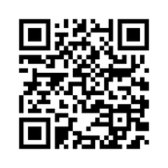
STUDENTS
Branch-level information
Use social media and the branch website to share general information and templates to put pressure on management, governing body, Office for Students, etc.
Inform at branch level and give them the tools to add pressure
Members direct to information
Provide templates for members to send to their students that remain informative – they do not need to declare participation necessarily, but should keep students informed on the boycott and link to branch resouces.
Students use Quality Assurance
templates from Summer 2022
Claim refunds, appeal grades, involve OfS. Office of the Independent Adjudicator only after internal procedure.
Failed graduation costs management
The Office for Students puts management under pressure over graduation. That is when students can get refunds.

Slide 9
EXTERNAL
Governing Bodies are responsible
Make management’s destruction of reputation and good governance their problem with letters, OfS intervention, etc.
Make the reputational damage and Quality Assurances the problem of the Governing Body
Expose Degree Certificate Model
Use social media and local media to expose rubbish feedback from scabs and lack of Quality Assurances
Reach out locally
Talk to local press, local trade unions, local pickets, the university's business connections, local politicians, etc.
Escalate up to ucu national
Get legal advice, media exposure, financial support by staying in touch with your regional offices and ucu national.

Slide 10
ENDING AND AFTERMATH
Protecting members
Settlement
Returning marks
Legal strategy
Deductions?
Agreement on dispute, on deductions, and on return of marks
Use hardship fund. Point out incorrect deductions. Use grievances and legal strategy.
Agree reasonable timeframe. Not for scab marks.
Grievances against disproportionate deductions. Legal action.

Slide 11
Exam Boards?
CHALLENGES
Can use to put on record the irregularities (for student appeals). Can use as sign 'partial performance' is accepted
WHAT BEST?
How to stop boycott-breaking?
Scabbing neutralises action. It is difficult to convince our own colleagues to get their priorities right, even more so when outsourced.
Make impact visible
Management downplays attack on quality
Supporting students in complaints
They need to get through the internal procedures before they can get to OiA.

Slide 12
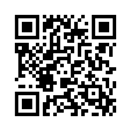
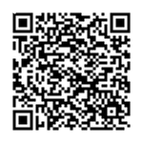
MAB RESOURCES
There is a lot of collective knowledge in the union about using MABs effectively.
Experiences
Student comms
Frameworks
www.qmucu.org
Students are key in making a marking boycott effective. Help them direct their rightful frustration to the right culprit. QMUL community solidarity created templates to write to governing body, to OfS, how to appeal grades, petition SET, etc.
Management will be acting and reacting based on the demands of the Office for Students. Familiarise yourselves with the Conditions for Registration to challenge any mitigation.
A number of branches have maintained successful marking boycotts. They have shared their advice. We have compiled these on our website.
www.qmucu.org
Socials: @qm_ucu

